Slide 1
Money and the Federal Reserve
17
Notes:
Pre-class music: “Money, Money, Money” by ABBA (See Tip #587)
According to this song, the only way to get the things one wants in life is to either work or find a wealthy partner to marry. The lyrics “All the things I could do if I had a little money” show that the opportunity cost of working is the time the singer could be spending doing the things she wants to do.
The other key concepts covered in this song are:
Medium of exchange
Trade-offs

Slide 2
Previously
Fiscal policy:
  Use of government spending [G] and taxes to influence the economy
  Increases in [G] and tax cuts are paid for by borrowing
Fiscal policy is not perfect because of lags, crowding out, and savings adjustments.
A higher MPC means a larger spending multiplier.
The Laffer curve:
  Shows the relationship between tax rates and tax revenues collected

Slide 3
Big Questions
What is money?
How do banks create money?
How does the Federal Reserve control the money supply?

Slide 4
How Money Is Defined and Measured
Currency
  Paper bills and coins
  All currency is money, but not all money is currency
Functions of money
  Medium of exchange
  A unit of account
  A store of value
Notes:
Lecture notes:
We use money all the time. Even little children know we use money to buy stuff. But what is included in our definition of money?
The quantity of money in the economy is important.
It affects the ease of making purchases and it affects the price level.
“Currency” is the bills and coins, but money is more than that.
In order to be considered money, three criteria must be met. Money must serve as a:
Medium of exchange
Unit of account
Store of value

Slide 5
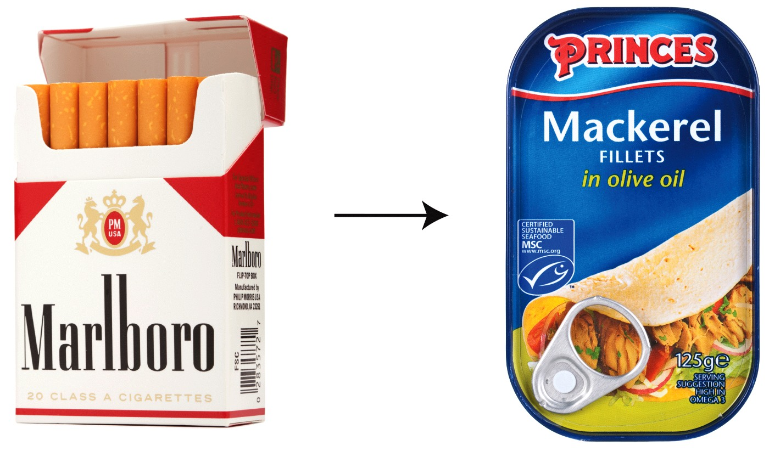
Medium of Exchange—1
Medium of exchange
  Money is how we pay for goods and services
  Other examples: tobacco in colonial times, cigarettes or mackerel in prison
Notes:
Lecture notes:
Money is the medium we use when we exchange goods and services.
If you want to buy a slice of pizza, you use money.
If you work, you will accept money as payment for your labor services.
Most modern economies have a common medium of exchange provided by the government.
For example, in the United States, we have U.S. dollars and coins, which are “legal tender for all debts, public and private.”
Cigarettes were once a popular form of money in prison.
Today, cigarettes are not allowed in many prisons, and the currency in use is mackerel, or “macks.”
It acts just like dollars today; no intrinsic value, but it is easy to trade.

Slide 6
Economics in The Shawshank Redemption
Medium of exchange
Notes:
“Economics in the Media” Slide
Lecture tip:
The clip mentioned on the slide can be found in the Interactive Instructor’s Guide. Access the direct link by clicking the icon in the PowerPoint above.
The other key concepts covered in this clip are:
Medium of exchange
Coincidence of wants
Prison money
Commodity money

Slide 7
Medium of Exchange—2
The alternative to money is barter.
A medium of exchange is preferred to bartering.
Consider an example:
  Suppose you have two blank notebooks with you in class, but you forgot a pen.
  Without money, you would have to find a classmate that has two pens and no notebook to trade.
  Referred to as a double coincidence of wants.
  It would be much easier to just pay someone currency for an extra pen.
Notes:
Lecture notes:
Barter:
Requires trading goods and services for other goods and services
In order to barter, you have to spend time, energy, and resources to find someone who wants what you have to trade and that has what you want.
The double coincidence of wants does not happen very often.
Therefore, a medium of exchange naturally evolves in any environment of trade and exchange.
Having an accepted currency that is “legal tender” for goods greatly increases trade and efficiency.

Slide 8
Economics in Planes, Trains, and Automobiles
Bartering
Notes:
“Economics in the Media” Slide
Lecture tip:
The clip mentioned on the slide can be found in the Interactive Instructor’s Guide. Access the direct link by clicking the icon in the PowerPoint above.
The other key concepts covered in this clip are:
Medium of exchange
Double coincidence of wants
Functions of money

Slide 9
Medium of Exchange—3
Commodity money
  Actual physical commodity (e.g., gold, silver, or tobacco)
Commodity-backed money
  Can be exchanged for a commodity at a fixed rate
Fiat money
  No value except as the medium of exchange
  No intrinsic value; just green paper
  Value comes from government decree
Notes:
Lecture notes:
Commodity money:
Commodities are often difficult to carry around when you need to make purchases.
Due to transportation costs, money evolved historically into certificates that represented a fixed quantity of the commodity.
These certificates became the medium of exchange, but were still tied to the commodity as commodity-backed money, since they could be traded for the commodity if the holder demanded it.
For example, in the first half of the twentieth century there were silver certificates that could be traded for actual silver.
Our currency is basically a bunch of green pieces of paper.
This paper has value though, because the government has mandated that we can use the currency to pay our debts.
On U.S. dollar bills, you can read the statement: “This note is legal tender for all debts, public and private.”
Fiat money:
However, fiat money has no intrinsic value.
You could argue that its value comes from the fact that we have faith in the money.
We believe that other people will accept the money in exchange for goods and services.
If people stopped accepting money, it would literally be worthless pieces of paper.
Regarding the images on the slide:
The money pictured here looks much like our modern money, but the dollar bill is a commodity-backed silver certificate from 1957.
At that time, it could be traded for a dollar’s worth of actual silver.
The quarter from 1964 is made of real silver.

Slide 10

Medium of Exchange: Commodity vs. Fiat Money
Commodity money
  Links money to something tangible
  Limits inflation
  Fluctuations in the commodity value change all prices
  New gold discovery→ inflation
Fiat money
  Not backed with a commodity
  Not subject to macroeconomic risk by changing commodity value
  Subject to rapid monetary expansion and inflation
Notes:
Lecture notes:
Commodity-backed money ties the value of your money to something with intrinsic value.
If the government is obligated to trade silver for every dollar in circulation, this certainly limits the number of dollars they can print and this likely limits inflation levels.
On the other hand, tying the value of your currency to a commodity is dangerous when the market value of the commodity fluctuates.
Changes in the value of your medium of exchange affect prices of all goods and services in the macroeconomy.
In this sense, it’s very risky to tie your currency to a commodity.
Imagine how a new discovery of gold affects prices in a nation with gold-backed currency, which leads to inflation.
Increased supply of gold reduces gold prices.
This requires more gold to purchase the same number of goods and services.
This is exactly what occurred in Europe as Spanish conquistadors brought back tons of money from Central and South America from the mid-fifteenth to the mid-seventeenth century.
The expansion of money is not constrained under fiat money. This is why rapid monetary expansion and then inflation often occur without a commodity standard.
For example, in 2016, Venezuela experienced inflation rates of over 150 percent.

Slide 11
Practice What You Know—1
Today in the United States, the dollar ($) is:
  intrinsically valued money.
  fiat money.
  commodity money.
  commodity-backed money.
Notes:
Clicker question:
Correct answer: B, fiat money.
Dollars are just green pieces of paper.
They have no value except as the medium of exchange.
There is no intrinsic value.

Slide 12

Unit of Account
Unit of account
  Measure in which prices are quoted
Usefulness:
  Creates a common language and unit of measurement
  Creates a consistent method of record keeping
Consider this: Could apples be a unit of account?
Notes:
Lecture notes:
Expressing the value of something in terms of dollars and cents also allows people to make accurate comparisons between items, by placing a value on a good that everyone can understand.
Think of your checkbook for a moment.:
You don’t write down that you bought a bagel and coffee in the ledger.
You write down that you spent $4.
Creates a “measuring stick” by which we can compare purchases.
Also creates a consistent measure for accounting: think about debits and credits in a ledger.
Regarding the image on the slide:
Fruit is easily tradeable.
We can easily count them.
Thus, they could be a unit of account.
We could set up exchange rates between apples and bananas.

Slide 13
Store of Value
Store of value
  A means for holding wealth
Consider this: Are apples a good store of value?
Usefulness:
  More convenient to hold wealth in money rather than a large amount of goods
  This role of money has declined recently due to:
    Stocks
    Bonds
    Savings accounts
Notes:
Lecture notes:
Traditionally, money served as an important store of value.
Think of the bags of gold coins from the Middle Ages.
Fruit is an appropriate unit of account.
But, fruit is NOT a good store of value since it can spoil.
In modern economies, this function is much less important, simply because we have so many other options that offer greater returns than keeping dollar bills in your sock drawer or stuffed into a mattress.
Today, we can easily put our dollars into a savings account or a money market account and then earn interest.
Given our many other options, money’s role as a store of value has certainly declined.
Class activity: Writing to Learn: 3-2-1
This could be a good time to use Tip #607: Writing to Learn: 3–2–1 from the Interactive Instructor’s Guide.
3. Briefly describe the three functions of money in an economy.
2. Give two examples from your own experience in which you were party to a double coincidence of wants.
1. In one sentence, argue why it is important for money to serve as a unit of account.

Slide 14
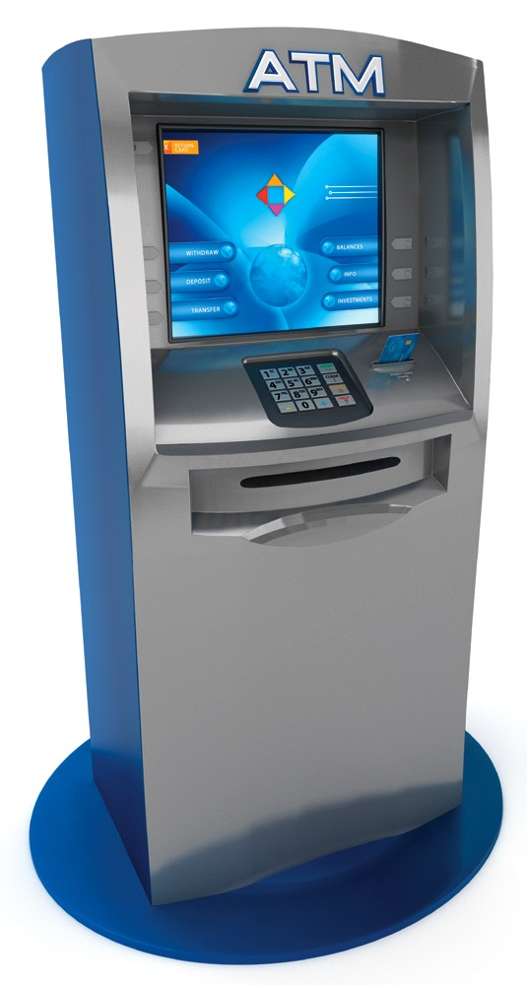
Measuring the Money Supply—1
Checkable deposits
  Bank deposits that allow withdrawal of money by writing checks
M1
  Composed of currency and checkable deposits
  Most used measure until 1970s, before ATMs
M2
  Includes M1, savings deposits, money market
  mutual funds, and CDs
Notes:
Lecture notes:
Measuring the money supply:
There are a couple of different ways to measure the money supply (beyond just currency).
Often, we refer to the money supply in terms of M1 or M2.
Checkable deposits: Represent purchasing power that is very similar to currency, since personal checks are accepted at many places.
M1:
M1 Also includes traveler’s checks, but those are small and becoming less important.
However, this measure has become less common as ATMs allow easy access to savings deposits as well.
M2:
M2 is now more reliable than M1 as a measure of the money supply.
M2 also includes two other types of deposits, money market mutual funds and small-denomination time deposits (certificates of deposit).
In M1, savings accounts are not considered as part of the money supply.
These accounts were often relatively inaccessible.
However, the ATM has greatly reduced transaction costs of getting money from savings accounts.
Savings accounts (as a part of M2) are now considered in the money supply.

Slide 15
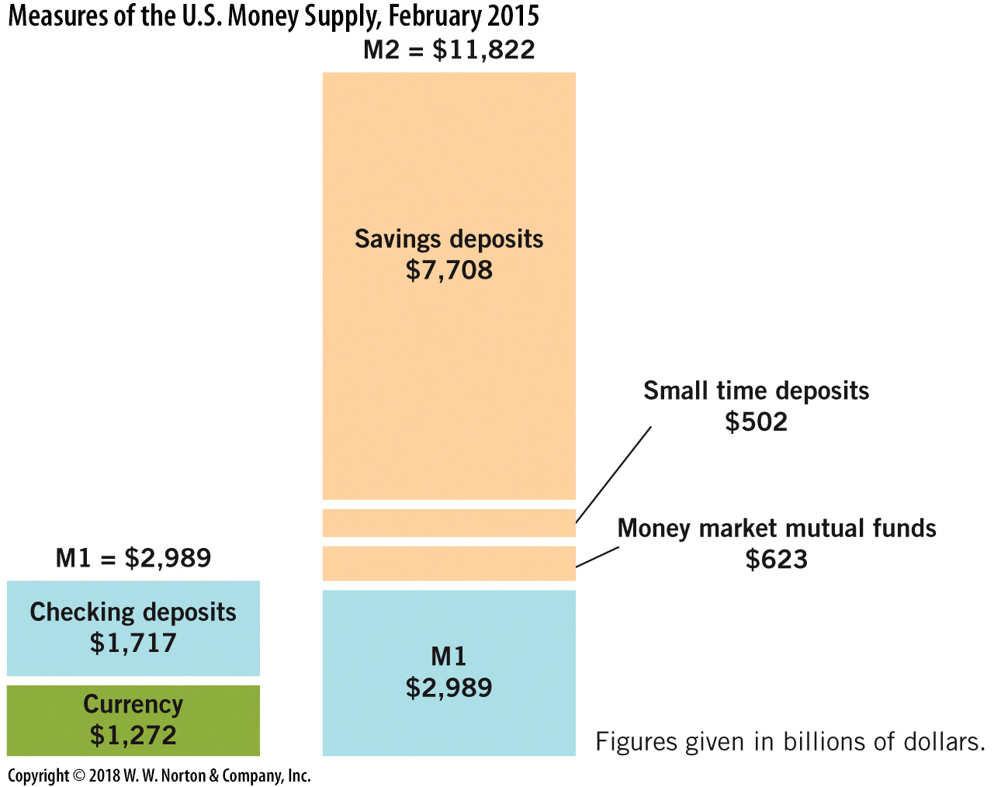


Measures of U.S. Money Supply: 2015
Notes:
Image: Animated Figure 17.1
Lecture notes:
First click:
M1 currency appears
Second click:
M1 checking deposits appears
Third click:
M1 total appears
Fourth click:
M2 money market mutual funds appears
Fifth click:
M2 small time deposits appears
Sixth click:
M2 savings deposits appears
Eighth click:
M2 total appears
M1 and M2 are the most common measures of the money supply.
M1 includes currency and checking deposits.
M2 includes everything in M1 plus savings deposits, small time deposits, and money market mutual funds.
Remember that the money supply includes both currency and bank deposits.

Slide 16
Practice What You Know—2
Why is M2 currently a more monitored measure of the money supply than M1?
  ATMs have allowed easier access to savings deposits.
  M2 doesn’t include coins, which may be obsolete in a few years.
  Banks pressured the Fed to include savings in the money supply measure.
  People have increased use of credit cards.
Notes:
Clicker question
Correct answer: A, ATMs have allowed easier access to savings deposits.
Before the ATM, savings were more difficult to access, so M1 was used, as it does not include savings deposits.
Now with the ATM, savings are readily available for purchasing goods and services.

Slide 17
Measuring the Money Supply—2
Debit cards
  Access checking and/or savings accounts
  Checking and savings accounts are included in M2
Credit cards
  Technically not a part of the money supply
  Involve a loan made at the cash register
  Bank deposits from elsewhere pay for the purchase
Notes:
Lecture notes:
Debit cards linked to savings accounts further reduce reliability of M1 (which excludes savings)
Why are credit cards not part of the money supply?
The purchases made with credit cards are purchases that involve a loan, a loan extended right there at the cash register.
When the loan is made, some third party is paying for the purchase, at least until the loan is repaid.
In this sense, there are bank deposits taken from somewhere else to pay for this exchange.
Credit card purchases use borrowed funds.
Real-world example: Bitcoin Currency
This would be a good time to use Tip #617: Real-World Example: Bitcoin Currency from the Interactive Instructor’s Guide.
Students have likely heard of Bitcoin, which is frequently debated in the media.
Discuss how Bitcoin is similar to and different from the money we use every day.
Have your students review the information in the following links or consider showing the Wall Street Journal video in class.
“How Bitcoin Works,” Personal Finance, Forbes, August 1, 2013, forbes.com.
“What’s a Bitcoin?” April 12, 2013, live.wsj.com.
After students have had a chance to research Bitcoins, open the floor for discussion on the pros and cons of virtual currency, based on what they have learned in this chapter.

Slide 18
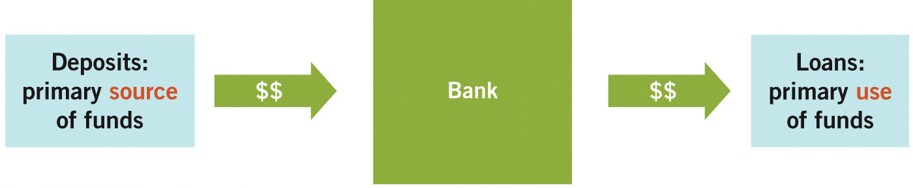
Business of Banking
Banks do not print money, but their actions affect the total money supply.
Notes:
Image: Figure 17.2
Lecture notes:
Banks:
While private individuals and firms are not permitted to print currency, private actions affect the total supply of money in the economy.
Banks create money as a byproduct of their daily business activity.
Banks are critical participants in the loanable funds market (discussed previously) and contribute in the money supply process.
Banks are middlemen in the market for loans.
They are financial intermediaries; that is, they take in deposits and extend loans.
Banks are profitable if they are able to make more (in interest payments) on the loans they extend than they pay out for the cost of their resources, which is primarily interest on deposits.
Deposits are the primary source of funds, and loans are the primary use of funds for banks.

Slide 19
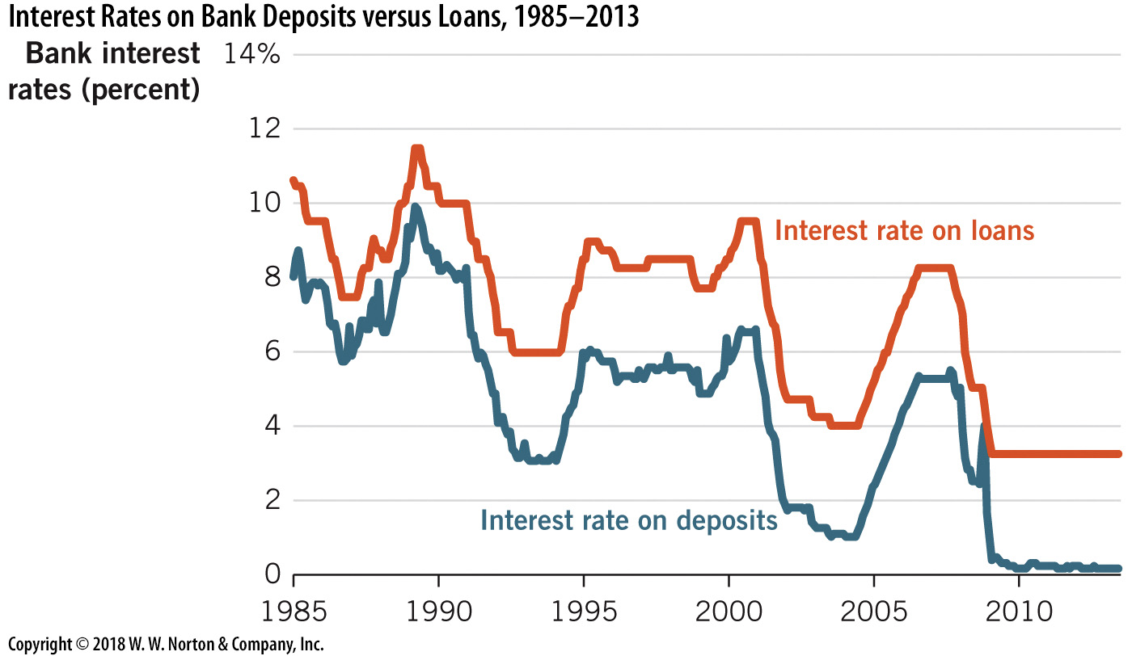
Interest Rates on Bank Deposits and Loans
Notes:
Image: Figure 17.3
Lecture notes:
The figure on the slide illustrates the gap between the interest rate on loans and the interest rate on deposits for average U.S. banks for the period 1985–2013.
The interest rate on deposits is consistently less than the interest rate the bank charges for loans.
The gap between these is the banking firms’ profit they earn for the important task of channeling funds to firms in the loanable funds market.

Slide 20
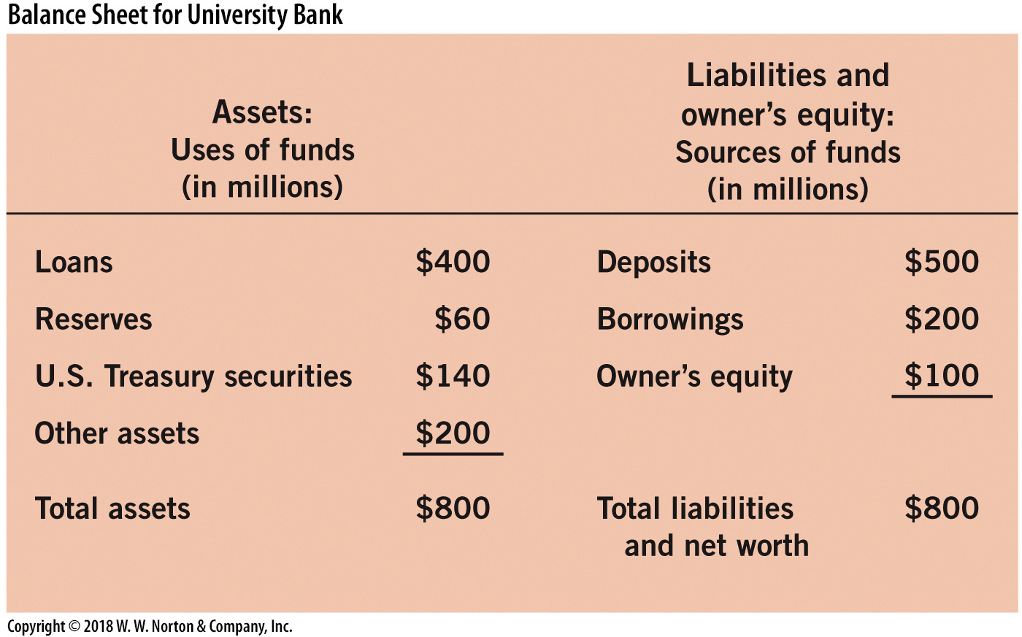
Bank Balance Sheet
Loans: Primary interest-earning use of bank funds
Reserves: Bank deposits set aside and not lent out
  Include currency at the vault and holdings at the Federal Reserve
Notes:
Image: Figure 17.4
Lecture notes:
The Federal Reserve is the bank for banks.
Bank balance sheet:
A bank’s balance sheet summarizes its key financial information.
On the left side, the bank’s assets are recorded, which shows how the bank chooses to use its funds.
The securities that the bank holds at the Federal Reserve earn interest and carry low risk.
On the right side, the bank’s sources of funds are reordered, which shows liabilities and owner’s equity.
The two sides of the balance sheet must match for the financial statement to be balanced.

Slide 21

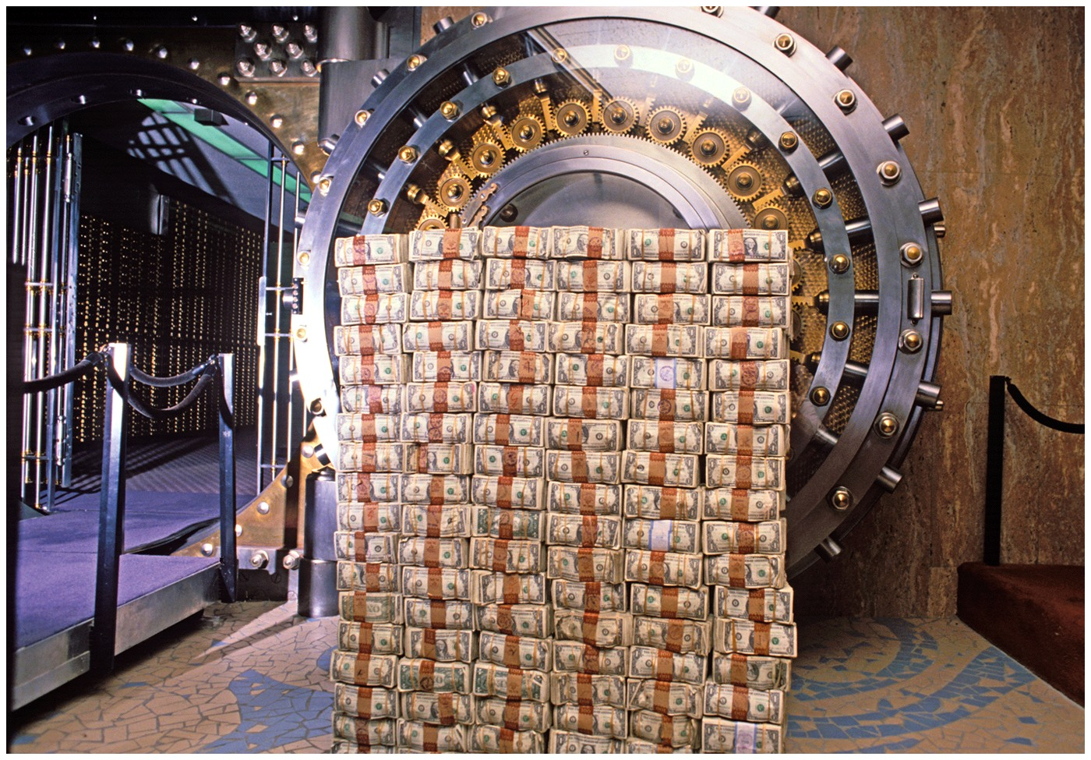
Bank Reserves—1
Fractional reserve banking
  Banks only hold a fraction of deposits on reserve.
  Typically, banks only keep 10% on reserve.
Cost of holding reserves
  Before 2008, reserves earned no interest
  The opportunity cost of holding reserves is the interest payments on loans
Notes:
Lecture notes:
In the United States, we have a fractional reserve banking system.
Banks do not have to hold all of their deposits as reserves.
The amount of required reserves (usually around 10 percent of deposits) is set by the Federal Reserve bank.
An alternative would be 100 percent reserve banking, where banks don’t loan out deposits.
The key reason why banks loan out most of their deposits is because reserves earn less interest than loans or securities.
In fact, before 2008 bank reserves earned no interest at all.
As such, there is an opportunity cost of holding reserves.
The opportunity cost of holding reserves is the interest payments never collected on loans never made.
Regarding the images on the slide: Banks earn money by lending out funds and borrowers pay interest to the bank.

Slide 22
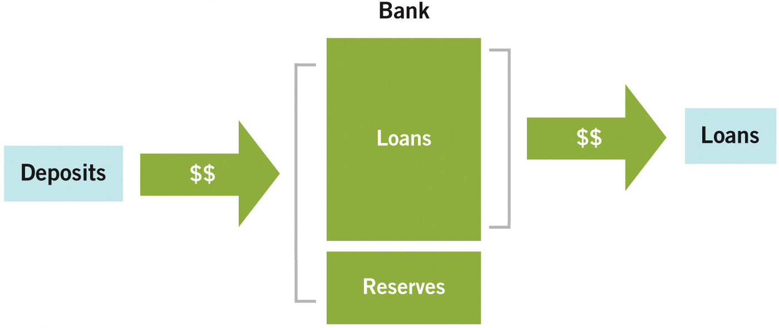
Fractional Reserve Banking
Notes:
Image: Figure 17.5
Lecture Notes:
The figure on the slide shows a fractional reserve bank.
Deposits come into the bank, but banks send out a portion of these in loans.
In recent years, U.S. banks have typically loaned out almost 90 percent of their deposits, keeping barely over 10 percent on reserve.
It is important to note that banks can keep more than 10 percent on reserve, but rarely choose to do so as it is less profitable than loaning that money out.

Slide 23
Bank Reserves—2
Reasons banks hold reserves:
  To accommodate customer withdrawals
  Requirements by the Federal Reserve
    Required reserve ratio (rr): proportion of deposits banks are required to keep on reserve
    The current rr is 10%
Bank run:
  Many depositors attempt to withdraw funds from a bank at one time
  May end with bank in default
Notes:
Lecture notes:
Banks hold reserves so that they can pay back customers when they request withdrawals from checking or savings accounts.
But banks are also required by law to keep part of their deposits on reserve.
The Federal Reserve requires banks to hold a fraction of their deposits on reserve.
The proportion of total deposits banks are required to hold is called required reserves.
Banks can always keep more than the required reserve ratio in their vaults, but it is generally less profitable for them to do so.
You would be pretty unhappy if you tried to make a withdrawal from your bank but they did not have enough on reserve to honor your request.
If word spread that a bank might have difficulty meeting the withdrawal requests of depositors, it would likely lead to a bank run.
A bank run is where many depositors attempt to withdraw their funds at one time.
The bank may end in default since it cannot meet all these requests at one time.

Slide 24
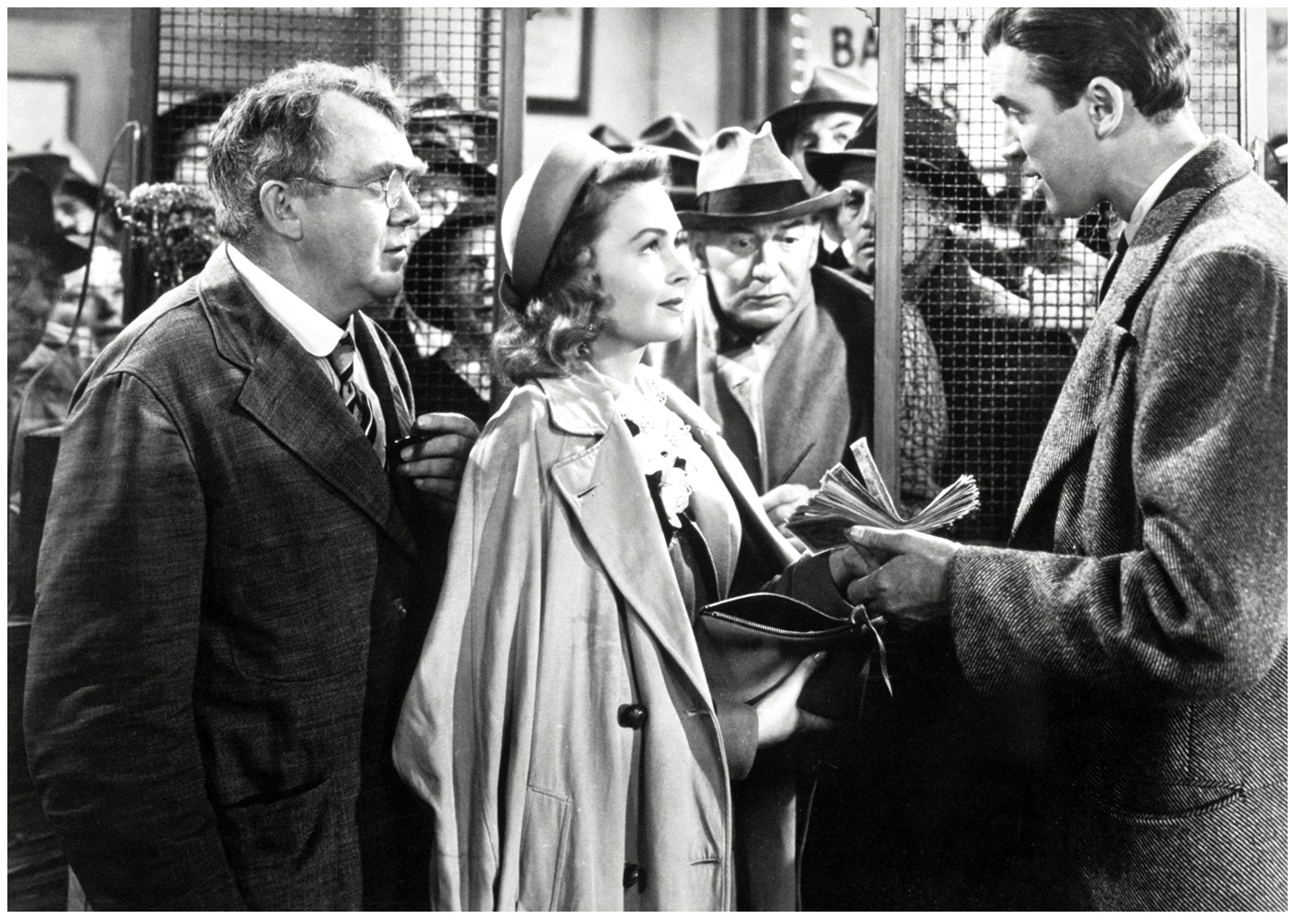
Economics in It’s a Wonderful Life
It’s a Wonderful Life (1946)
  This is the bank run scene.
  During the Depression, bank runs caused the failure of many banks.
Notes:
“Economics in the Media” Slide
Lecture tip:
The clip mentioned on the slide can be found in the Interactive Instructor’s Guide. Access the direct link by clicking the photo in the PowerPoint above.
This clip is also in the Chapter 14 PowerPoint (on Great Recession, Great Depression).

Slide 25
Bank Reserves—3
The dollar amount of required reserves:
Required reserves = rr × deposits
Excess reserves:
  Reserves over the required level
  Generally small
Excess reserves = total reserves – required reserves
Notes:
Lecture notes:
The mathematics of bank reserves up to this point is pretty simple.
Banks must keep a fraction of their deposits as reserves, and any extra they keep beyond that is excess reserves.
Real-world example: India Cuts Interest Rates and Reserve Requirements
This could be a good time to use Tip #616: Real-World Example: India Cuts Interest Rates and Reserve Requirements.
Share the article mentioned below with your class to give them an example of a country using these tools to affect the money supply.
Kartik Goyal, “India Cuts Key Rate to Spur Growth as Inflation Cools,” Bloomberg, January 29, 2013, bloomberg.com.

Slide 26
Moral Hazard and the FDIC
Is the reserve requirement necessary?
  Need to keep customers happy
  Bank run would ruin the bank
Federal Deposit Insurance Corporation (FDIC)
  Government program that insures your bank deposits
  Goal: increase bank stability, decrease bank runs
  Before FDIC: 9,000 bank failures from 1929 to 1933
  Created moral hazard situation
    Moral hazard: lack of an incentive to guard against risk
Notes:
Lecture notes:
Is the reserve requirement necessary since banks have their own incentives to hold reserves?
Banks are incentivized to hold reserves to avoid a bank run and maintain customer confidence.
A bank run would destroy a bank’s reputation and future.
The purpose of deposit insurance is to guarantee depositors that, even if their bank goes bankrupt, they will get their deposits back (up to $250,000).
It means depositors have less incentive to line up in a bank run and demand their deposits; the government insures they will get them.
FDIC insurance has greatly decreased the frequency of bank runs.
However, the FDIC has also created a moral hazard situation.
Moral hazard is when there is the lack of incentive to guard against risk where one is protected from its consequences.
This is an unintended consequence of FDIC.
Banks have no incentive to monitor risk; they can increase their risks/rewards, but not be concerned about the costs (defaulting).
Depositors also have little incentive to monitor risk, since they are protected from its consequences.

Slide 27
Moral Hazard: Example
Type A bank
  Conservative, no risk, earns low returns on their loans
  Almost never fails, but gives small returns on deposits
Type B bank
  Takes big risks in hopes of earning big returns
  Fails often, but the surviving ones pay huge returns
  Even if the bank fails, deposits are insured by the FDIC
Where would you choose to deposit your money?
Notes:
Lecture notes:
Type A Bank:
Type A bank makes very safe investments with low rates of return and failure.
Type A bank has low profits and consequently pays low interest to depositors.
Type B Bank:
Type B bank can get big returns but with high default risk.
However, if the type B bank fails, the FDIC protects depositors against losses.
Remember that incentives matter.
When considering financial instability, recessions often start in the financial industry.
This is why policies such as required reserves exist—to help ensure stability in the financial sector.

Slide 28
Economics in Friends, “The One Where Joey Loses His Insurance”
Moral hazard
Notes:
“Economics in the Media” Slide
Lecture tip:
The clip mentioned on the slide can be found in the Interactive Instructor’s Guide. Access the direct link by clicking the icon in the PowerPoint above.
The other key concept covered in this clip is:
Incentives

Slide 29
How Banks Create Money—1
Some important notes:
  The money supply includes both currency and deposits
  Our modern banking system is a fractional reserve system
  Banks function as financial intermediaries
  Banks do not mint currency
Notes:
Lecture notes
Recall that the money supply includes bank deposits and currency.
So, new deposits create money.
The modern banking system in the United States is a fractional reserve system, meaning that banks loan out a fraction of the deposits they receive.
Tricky wording: you can say “banks create money” with the intent of saying that by lending, more money is put into the economy.
However, banks don’t mint new bills or coins.
Banks create money when they loan out part of their deposits.
This is how banks create money (expand the money supply) without minting currency.

Slide 30
How Banks Create Money—2
Storyline:
Deposit $1,000
Bank loans out 90% ($900)
Can withdraw initial $1,000 deposit
Someone else has a $900 loan
New money!
Notes:
Lecture notes:
You deposit $1,000 in bank.
Bank loans out part of that money (up to $900).
You can still get your $1,000 deposit back.
Someone else now has money from the bank.
New money is created!

Slide 31
Example of Banks Creating Money—1
Two simplifying (but unrealistic) assumptions:
  All currency is deposited in a bank
  Banks hold no excess reserves (rr = .10)
Example:
  Alexis gets a $900 loan to pay for college tuition
  The college deposits this money in its bank
  This bank then lends out the money
Let’s examine the balance sheets of each bank.
Notes:
Lecture notes:
Suppose that all currency is deposited and banks hold no excess reserves.
Holding no excess reserves means that the bank will loan out 90 percent of its deposits.

Slide 32
Example of Banks Creating Money—2
University Bank (the bank from which Alexis borrowed the $900)
Assets |  | Liabilities and Net Worth
Reserves | +$100 | Deposits | +$1,000
Loans | +$900
Township Bank (the bank the college uses)
Assets |  | Liabilities and Net Worth
Reserves | +$90 | Deposits | +$900
Loans | +$810
Notes:
Lecture notes:
In order for Alexis to receive the initial $900, someone had to deposit at least $1,000 in University Bank.
In this simple example, the original $1,000 was turned into $1,900.
If we allowed this process to continue, it would be $2,710 ($1,900 + 810) if we included the next borrower.
This process could continue on and on, similar to the spending multiplier.

Slide 33
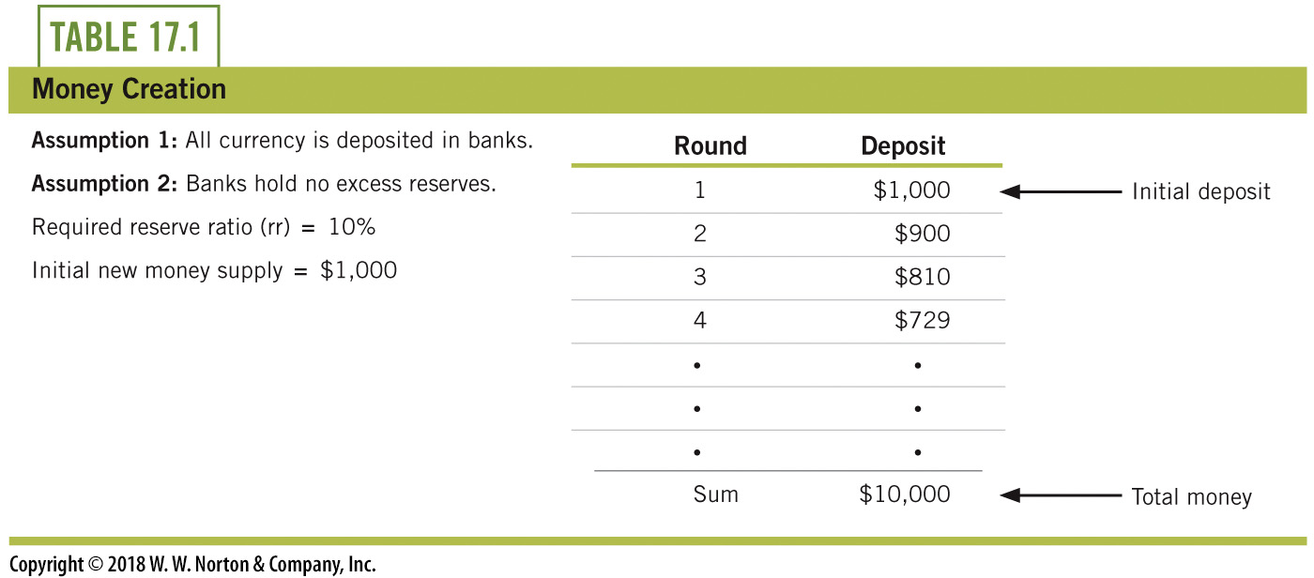
Example of Banks Creating Money—3
Notes:
Lecture notes:
A byproduct of a fractional reserve banking system is money creation.
As long as dollars find their way back into the banking system, banks can continue to multiply them into more deposits, which means more money.
Banks can’t print currency, but they can multiply deposits and deposits are part of the money supply.

Slide 34
Practice What You Know—3
Banks increase the money supply by:
  printing (minting) money.
  controlling interest rates.
  lending out funds to borrowers.
  storing the money of savers.
Notes:
Clicker question:
Correct answer: C, lending out funds to borrowers.
When banks lend, more money is in circulation.
I deposit my money, and you take out a loan.
You now have money, and I can still get my money from the bank.

Slide 35
Money Multiplier
Simple money multiplier
  Rate at which banks multiply money when
    All currency is deposited into banks
    Banks hold no excess reserves
Realistically:
  Represents maximum size of money multiplier
Notes:
Lecture tip: Careful: This is not to be read as “m to the m power.”
It is just “m m,” or money multiplier.
Lecture notes:
m^{m} is the simply money multiplier.
It is inversely related to the reserve requirement.
In other words, if banks can lend out MORE of their deposits (lower rr), then the money multiplier will increase.
Recall the two assumptions from earlier:
All currency is deposited in a bank.
Banks hold no excess reserves.
If these assumptions do not hold, the money multiplier will be smaller.

Slide 36
Practice What You Know—4
With a reserve requirement of 5% and an initial deposit of $400, what is the total amount of money that could be in the money supply?
  $420
  $780
  $4,000
  $8,000
Notes:
Clicker question
Correct answer: D, $8,000
Use the simply money multiplier.
m^{m} = (1 / rr). In this case, the money multiplier is m^{m} = 20.
20 * $400 = $8,000.

Slide 37
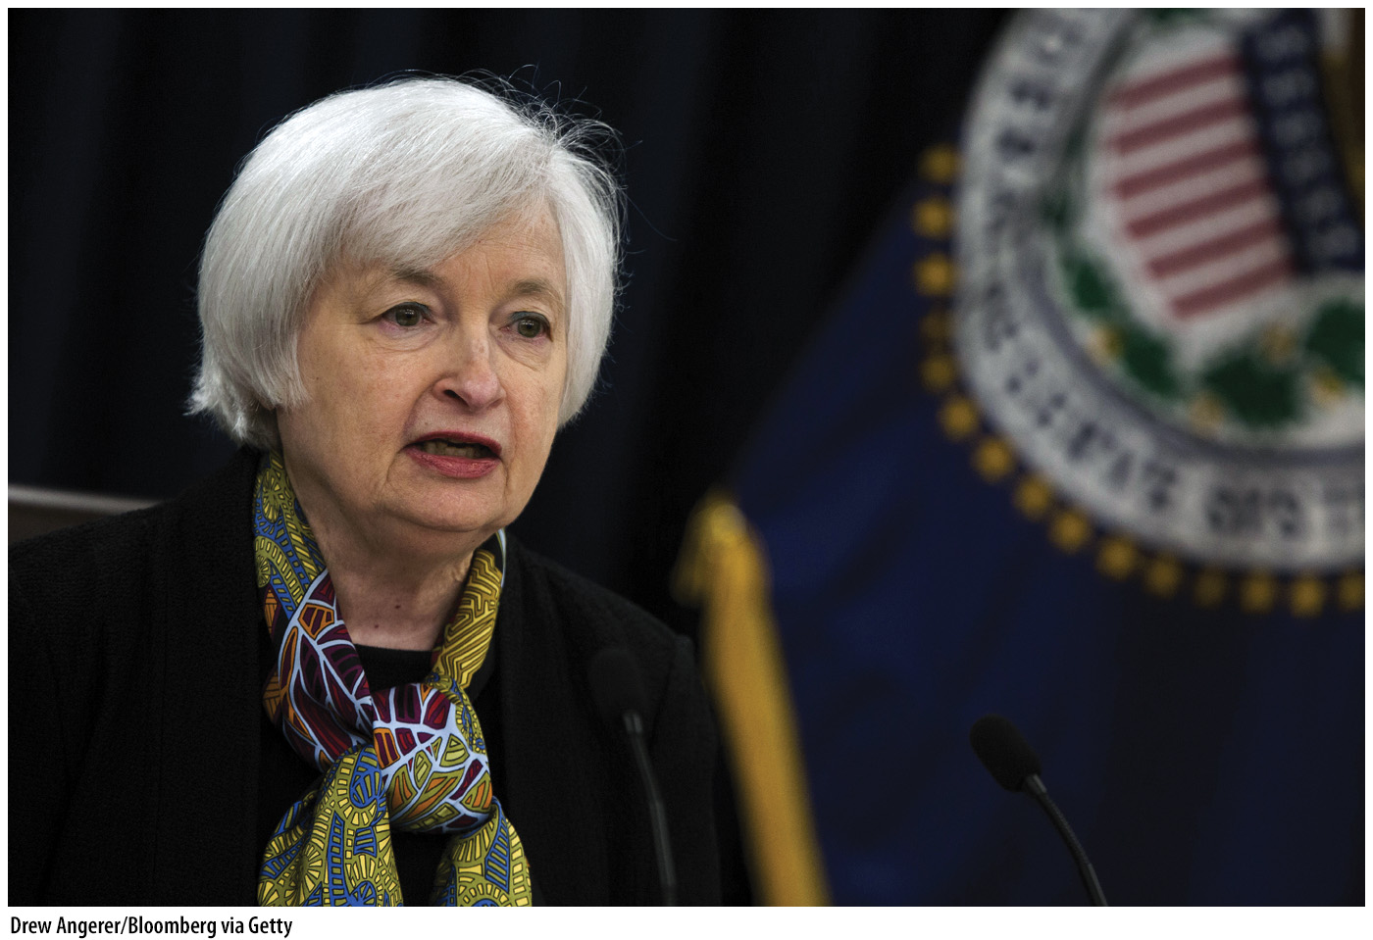
The Federal Reserve
The Federal Reserve (Fed): central bank of United States
Three responsibilities:
  Monetary policy
  Central banking
  Bank regulation
Current chairman of the Fed
  Janet Yellen
Notes:
Lecture notes:
The Federal Reserve:
The Federal Reserve Act established the Fed as the central bank of the United States in 1913.
The responsibilities of the Fed include:
Conducting monetary policy: manipulating the money supply to reduce macroeconomic fluctuations.
Serving as the bank for banks (i.e., holding deposits and issuing loans to banks).
Regulating banks and ensuring financial stability of banks.

Slide 38
Roles of the Federal Reserve—1
Central bank
  The Fed is a “bank for banks”
  Offers support and stability for the banking system
Federal funds
  Private bank deposits at the federal reserve
Federal funds rate
  The interest rate on loans between private banks
  Negotiated between private banks, not set by the Fed
Notes:
Lecture notes:
Federal funds are deposits that private banks hold on reserve at the Fed.
The word “federal” seems to denote that these are government funds, but they are private funds held on deposit at a federal agency (the Fed).
These deposits are part of the reserves that banks set aside, along with physical currency in the vault at the bank.
Banks keep reserves at the Fed so the Fed can clear loans between banks.
These are often very short-term loans.
Banks also make loans to each other in order to make quick adjustments to their balance sheets.
For example, if a bank is below its reserve requirement at the end of the day, they may take out a short-term loan from another bank.
The federal funds rate is the interest rate on loans between banks.
While this rate is not set by the Fed (it is negotiated between private banks), the Fed uses monetary policy to make the rate rise and fall within a target region.
In recent times, this has been the most influential monetary policy tool (although, since 2008, the focus has shifted away from the federal funds rate).

Slide 39
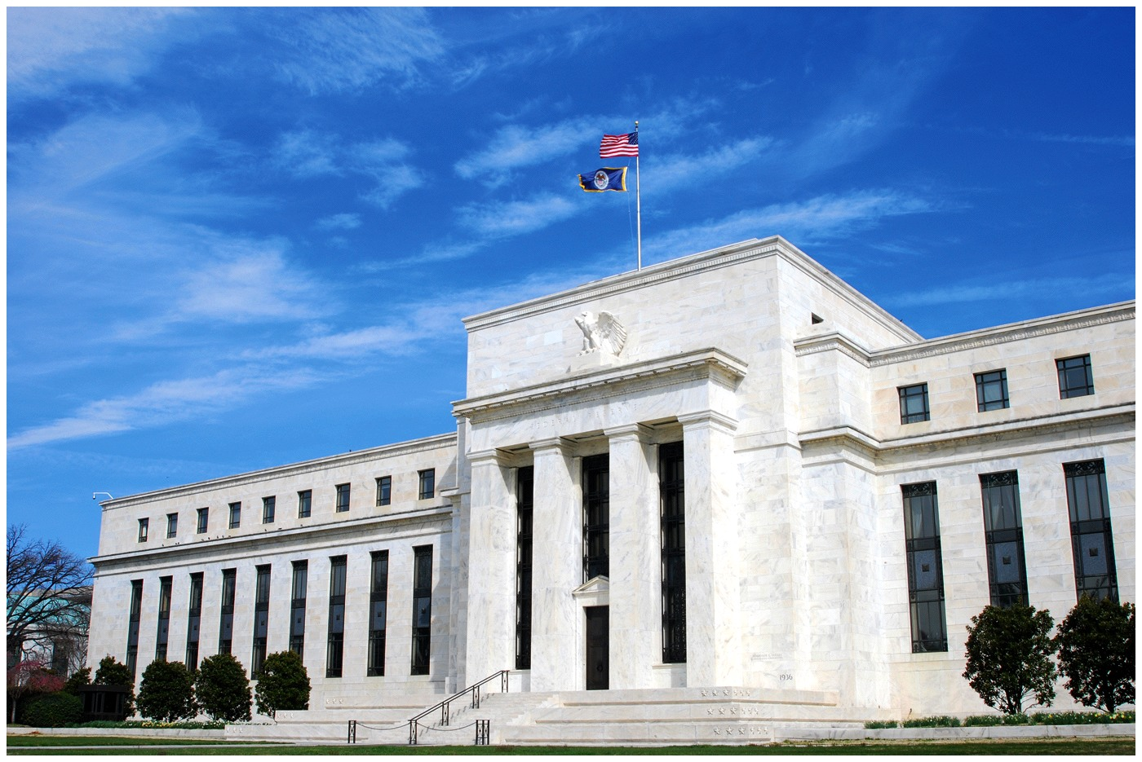
Roles of the Federal Reserve—2
Discount loans
  Loans from the Fed to private banks
  The Fed is the “lender of last resort”
  Not used frequently, but reassuring during crises
Discount rate
  The interest rate on discount
  loans
Regulates individual banks
  Sets and monitors reserve
  requirements, limits risks
Notes:
Lecture Notes:
When banks were struggling in 2008, financial market participants were assured that troubled banks could rely on the Federal Reserve to fortify failing banks with discount loans.
In fact, for the first time in history, other financial firms were allowed to borrow from the Fed.
The Fed even extended an $85 billion loan to A.I.G. (an insurance company) that had written insurance policies for financial securities.
Recall that with the FDIC and the existence of moral hazard, both depositors and banks have reduced incentives to monitor the risk of bank assets.
The government can help regulate this.
As a regulator of banks, the responsibilities of the Fed include the setting and monitoring of reserve requirements.
The Fed monitors the balance sheets of banks with an eye toward limiting the riskiness of the assets banks hold.
Why monitor private banks’ risks but not other private firms?
Due to the interconnectivity of assets, bank problems can quickly spread to the entire industry.
Moral hazard in banking industry (related to FDIC, discussed earlier).
Image on the slide: Federal Reserve in Washington, D.C.

Slide 40
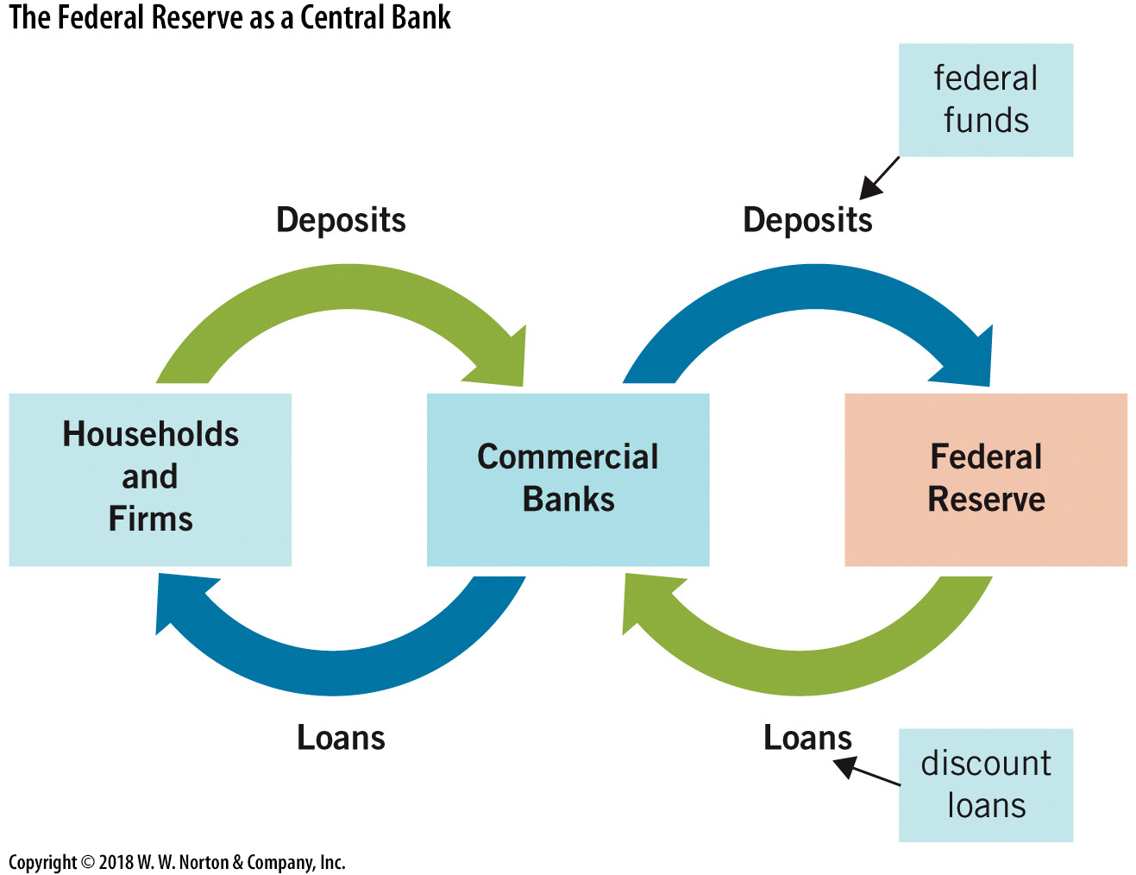
Federal Reserve: A Bank for Banks
Notes:
Image: Animated Figure 17.6
Lecture notes:
The figure on the slide illustrates how the relationship between the Fed and banks is analogous to the relationship between banks and households and firms.
First, we hold deposits at banks, and banks hold deposits at the Fed; these are the “federal funds.”
Second, we take loans from banks, and banks take loans from the Fed; these loans are called “discount loans.”
First click:
Commercial Banks box appears.
Second click:
Households and firms make deposits into commercial banks.
Commercial banks loan to households and firms.
Third click:
Federal Reserve box appears.
Fourth click:
Commercial banks make deposits into the Federal Reserve.
The Fed loans to commercial banks.

Slide 41
Monetary Policy Tools
Open market operations
  Primary single tool of monetary policy
  Fed created a new version in 2008
Secondary tools
  Reserve requirements
  Discount rates
Special case: 2008
  Fed implemented 9 new monetary policy tools
Notes:
Lecture notes:
The Fed undertakes open market operations every business day.
Typically, the goal is to keep market conditions exactly as they were the day before.
But open market operations is also the primary tool used to expand or contract the money supply in order to affect the macroeconomy.
In 2008, the Fed implemented nine new monetary policy tools, creatively attempting to provide funds to financial markets in the midst of unstable conditions.

Slide 42
Open Market Operations—1
Open market operations
  The purchase or sale of bonds by a central bank
  Buys securities → increase money supply
  Sells securities → decrease the money supply
Why Treasury securities?
  Funds go directly into the market for loanable funds.
  Can buy and sell large volumes daily ($500 billion)
Notes:
Lecture notes:
With open market operations, the Fed uses new money to buy something in the economy.
What do they buy? They usually buy U.S. Treasury securities.
If the Fed bought tangible goods, commodities, or real estate (as opposed to securities), it’d cause problems in that market.
Imagine you are the manager of a bagel shop in Washington, D.C., and Janet Yellen walked in with a request for $20 billion worth of bagels.
It would have the same effect on the money supply but would also have negative consequences.
But the market for U.S. Treasuries is big enough to accommodate these purchases seamlessly.
The daily volume in the U.S. Treasury market is over $500 billion, so the Fed can buy and sell without difficulty.

Slide 43
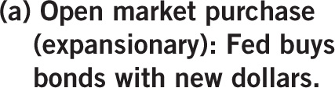
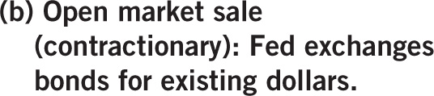








Open Market Operations—2
Notes:
Image: Animated Figure 17.7
Lecture notes:
The figure on the slide summarizes how open market operations work.
When the Fed purchases bonds, it essentially creates new money and trades this money with financial institutions for their Treasury bonds.
The end result is more money in the economy.
On the other side, when the Fed sells bonds to financial institutions, it exchanges bonds for existing money, essentially taking the money out of the economy.
The end result is less money in the economy.
First click:
Fed and Financial Institutions boxes appear on the left.
Second click:
“Bonds” arrow from financial institutions to fed
Third click:
“$$” arrow from fed to financial institutions.
Fourth click:
Result: More money in the economy.
Fifth click:
(b) Open market sale (contractionary): Fed exchanges bonds for existing dollars.
Sixth click:
Fed and Financial Institutions boxes appear on the right.
Seventh click:
“Bonds” arrow from fed to financial institutions
Eighth click:
“$$” arrow from financial institutions to fed.
Ninth click:
Result: Less money in the economy.

Slide 44
Quantitative Easing
End of 2008, worst quarter in United States economy in 50 years
  Real GDP down 8.9%, unemployment up
  Fed decided additional measures needed
Quantitative easing
  Targeted use of open market operations where the central bank buys securities in certain markets
  Targeted the housing market
  Unprecedented
Notes:
Lecture notes:
Typically, open market operations involves buying and selling short-term Treasury securities, bonds that mature in less than one year.
With quantitative easing, the Fed expanded purchases to include $300 billion of long-term Treasury securities.
Not only that, but the Fed also purchased $1.25 trillion in mortgage-backed securities, specifically targeting the housing market.
Together with an additional $175 billion in purchases of securities from government-sponsored enterprises, this amounted to almost $2 trillion worth of new funds injected into the economy.
It amounts to the Fed printing trillions of new dollars and putting them in targeted sectors.

Slide 45
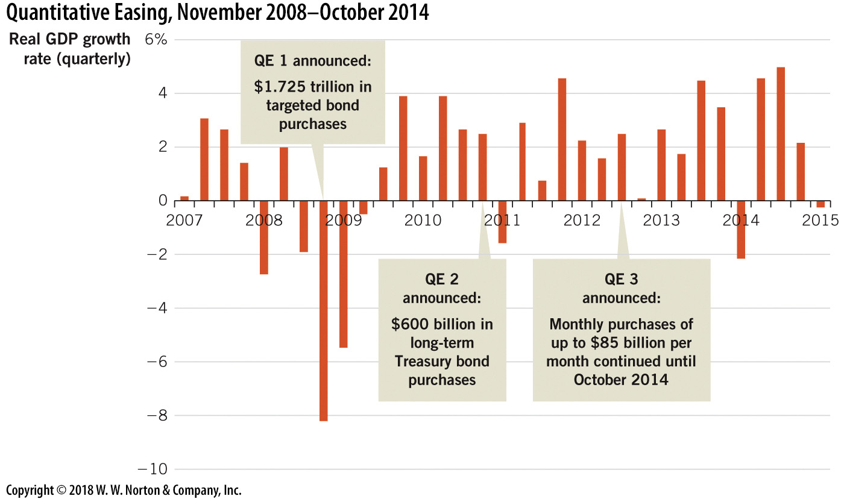
Quantitative Easing
2007–2014
Notes:
Image: Figure 17.8
Lecture notes:
Fed had already bought so many securities on the open market, the lower interest rates caused by these huge purchases had already pushed short-term interest rates down to zero.
This was the boundary of actions the Fed could take with regard to influencing short-term rates, so the Fed looked for other tools.
The first round of quantitative easing started in November of 2008 and continued into the first quarter of 2010.
At that point, the Fed was convinced that economic recovery was well underway.
But conditions deteriorated over the second half of 2010, as the unemployment rate stayed around 9 percent and real GDP growth stalled.
In November 2010, the Fed decided to engage in a second round of quantitative easing, dubbed “QE 2.”
This round involved purchases of an additional $600 billion of long-term Treasury securities.
The figure illustrates the timeline for these quantitative easing programs along with the quarterly growth rates of real GDP.
The Fed implemented each of these when it was clear that traditional open market operations would not return the economy to stable growth rates.
In September 2011, as the economy continued to struggle toward consistent growth, Bernanke announced yet another variation of quantitative easing.
The Fed would buy $400 billion worth of long-term Treasury securities and simultaneously sell $400 billion worth of short-term Treasury securities.
This action became known as a “twist,” since it was not really adding money to the economy but attempting to reduce long-term interest rates and thereby encourage business investment.
In September 2012, the Fed announced an ongoing program to buy $40 billion worth of securities per month (this amount was later increased to $85 billion).
This program, which became known as QE 3, lasted until October 2014.

Slide 46
Reserve Requirements
Two additional tools (not used recently)
  Reserve requirements
  Discount rate
Reserve requirements
  The Fed sets the reserve requirement ratio = rr
  The simple money multiplier m^{m} depends on rr
  The Fed can change the money multiplier by changing the reserve requirement
Notes:
Lecture notes:
These two alternative monetary policy tools are historically important but have not been used recently.
This implies that the Fed can change the money multiplier by changing the reserve requirement ratio.
If the Fed lowers the reserve requirement ratio, the money multiplier increases.
If the Fed raises the reserve requirement ratio, the money multiplier falls.

Slide 47
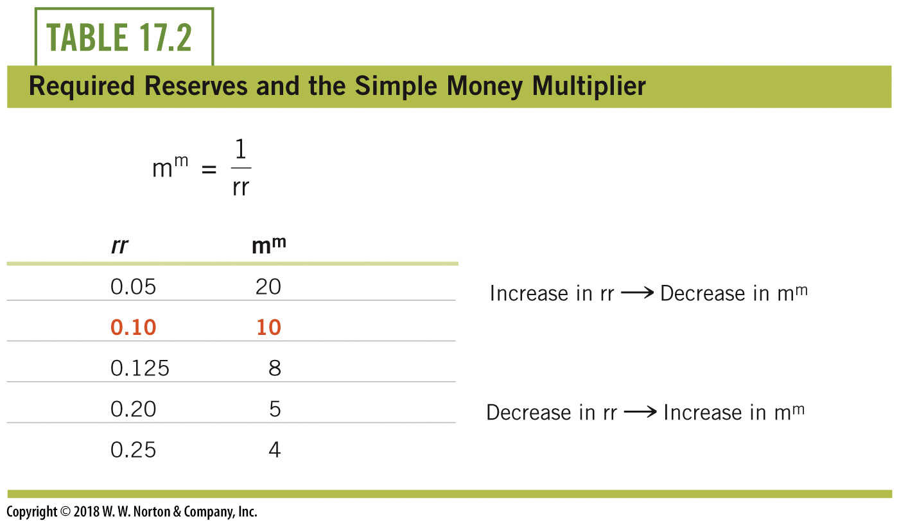
Reserve Requirements and the Simple Money Multiplier
Notes:
Lecture notes:
Raising the reserve rate means that the simple money multiplier will fall.
Changing reserve requirements has unpredictable outcomes because the overall effects depend on the actions of banks.
It is possible that the Fed could lower the reserve requirement and banks would not change their reserves.
They still need some funds set aside in case customers seek withdrawals.
So while this tool is very powerful in theory, in practice, its effects are unpredictable.

Slide 48
Discount Rate
Discount rate: Original monetary policy tool
  The interest rate charged on loans to banks from the Fed
Historically
  Fed would increase the discount rate
  → discourage borrowing by banks
  → decrease money supply (or vice versa)
  Used actively until Great Depression era
Today
  No longer considered useful
Notes:
Lecture notes:
In their role as the lender of last resort, the Fed makes loans to banks called discount loans.
Their interest rate on discount loans is called the discount rate.
Today, discount borrowing is discouraged unless banks are struggling.

Slide 49
Practice What You Know—5
Discount loans are:
  loans offered by private banks at a lower interest rate.
  cheap loans to individuals from nonbank businesses.
  loans from the Fed to private banks.
  loans private banks make to each other.
Notes:
Clicker question:
Correct answer: C, loans from the Fed to private banks.
From the text:
We hold deposits at banks, and banks hold deposits at the Fed; these are the federal funds.
Second, we take loans from banks, and banks take loans from the Fed; these are discount loans.
Discount loans are loans from the Fed to private banks.

Slide 50
Nine New Monetary Tools
Deep recession at end of 2008
Two varieties of new tools
  Target specific areas of the economy, including loans by consumers, students, small businesses, and short-term corporate loans.
  Fed began paying interest on bank reserves
    Lowers the opportunity cost of reserves
    Gives the Fed an additional measure to affect the money supply by changing this interest rate
Notes:
“Beyond the Book” Slide
Lecture notes:
In October 2008, the Fed announced it would begin paying interest on bank reserves.
While the interest rate on reserves has thus far been below market rates, it does reduce the opportunity cost of bank reserves.
In addition, it offers the Fed an additional means to affect the money supply.
Lowering this rate encourages banks to lend excess reserves and therefore increase the money supply via the multiplier.
Raising this rate encourages banks to hold more reserves and this decreases the money supply via the multiplier.
Real-world example: New Tools of Monetary Policy (See Tip #619)
Students who are keeping up with the news will now hear about monetary policy tools like interest on excess reserve, reverse repurchasing agreements, and forward guidance.
It is important for students moving on in macroeconomics to understand these new tools of monetary policy.
The Wall Street Journal does a great job explaining these tools in a 3.5-minute video:
“How Interest Rates Are Set: The Fed’s New Tools Explained,” WSJ Video, September 17, 2015, wsj.com.

Slide 51
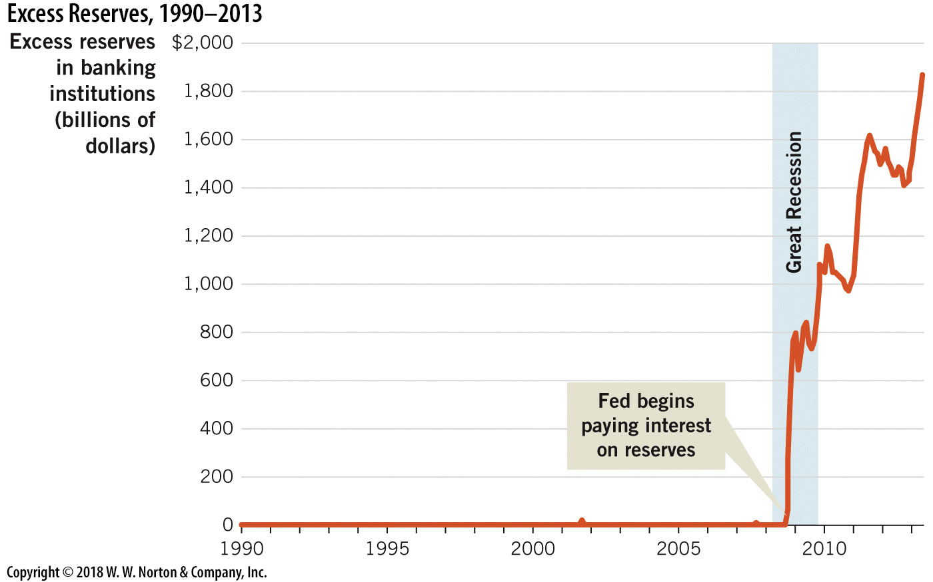
Excess Reserves, 1990–2013
Notes:
Image: Figure 17.9
Lecture notes:
Banks began holding significant excess reserves in 2008.
Part of this was due to the risky nature of loans during the Great Recession, but it is no coincidence that the excess reserves climbed immediately after the Fed began paying interest on reserves.

Slide 52
Conclusion
Money includes currency and bank deposits
Banks expand the money supply by issuing loans
The Fed influences the macroeconomy using:
  Open market operation
  Discount loans
  Reserve requirements
Since 2008, the Fed has new policy tools

